Slide 1
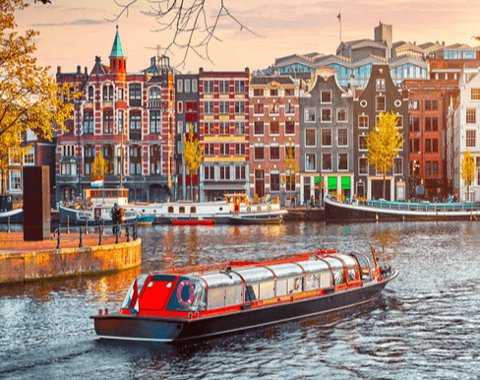
Dream Cities
Authors:
Ilia Marinov
Peter Petkov
Peter Stoev
Kameliq Qneva
Marieta Stoicheva
Teodora Kompanska

Slide 2
Goals and Purpose
To introduce people to the most beautiful cities in Europe.
You can learn many interesting facts about them too.

Slide 3
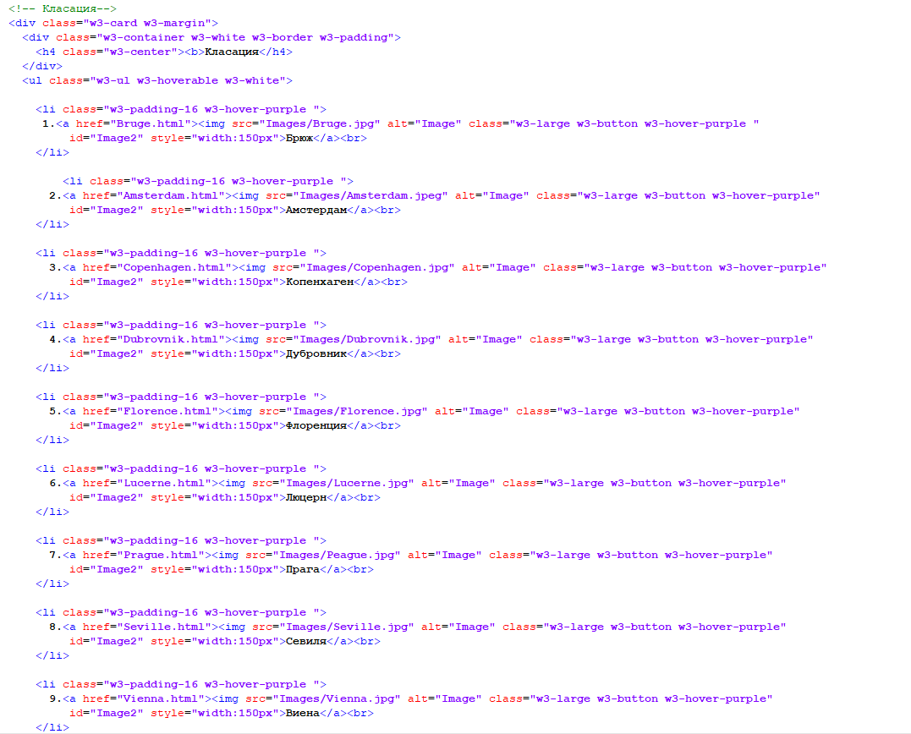
Stages Of Development
ANALYSIS
PLANNING
REALIZATION

Slide 4
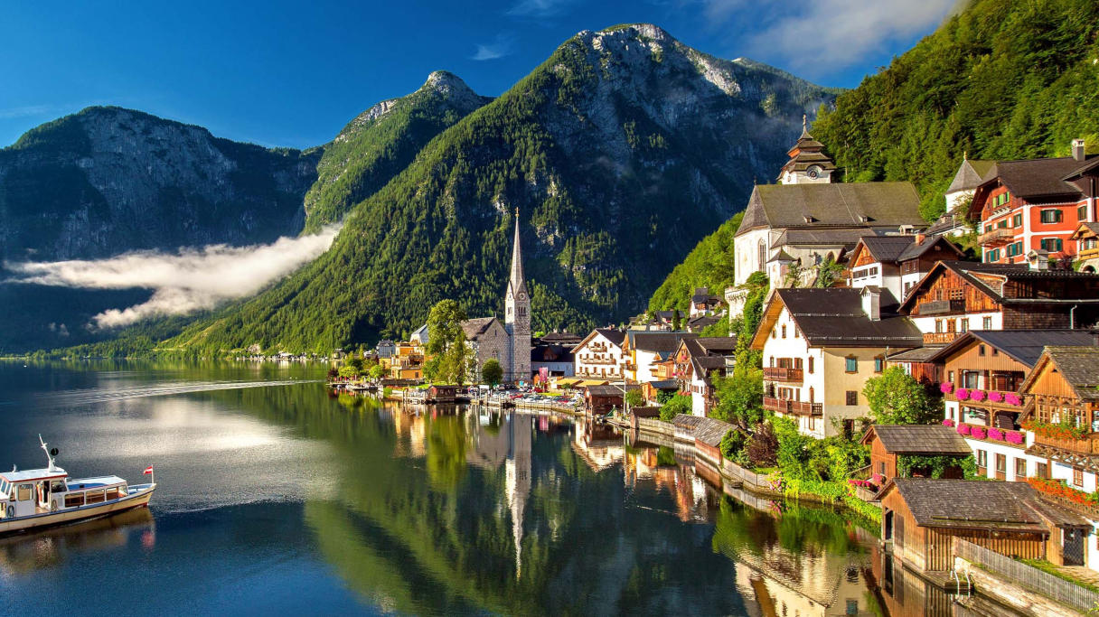
SOFTWARE AND RESOURCE
Programing Language-HTML and CSS

Slide 5
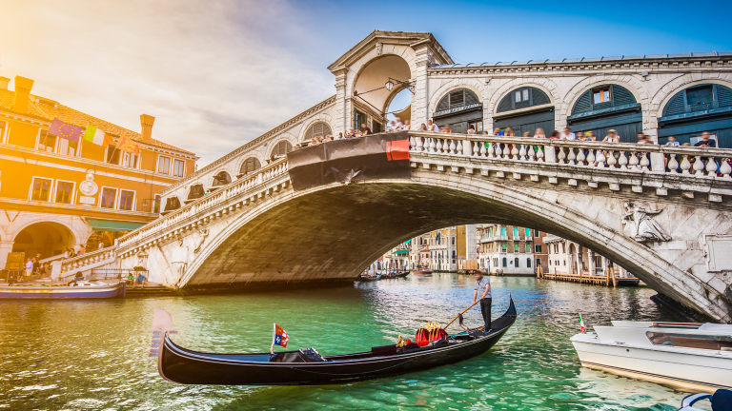
Program the future...
...into a better world...

